Slide 1


Daniel Kwan
August 14, 2025

Slide 2

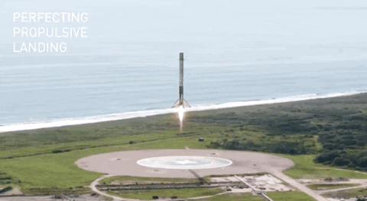
Outline
Executive Summary
Introduction
Methodology
Results
Conclusion
Appendix

Slide 3
Executive Summary
Methodologies
Coding were performed using Python with appropriate libraries.
Publicly available data (from SpaceX API and Wikipedia) were compiled into a dataset.
The dataset were analyzed to determine which feature impacted the landing outcome.
Classification models were developed to predict landing outcomes and compared with each other.
Summary of all results
Individual mission parameters such as orbit, payload mass, and launch site do not show substantial correlation with the landing outcome.
From 2013 to 2020, the success rate of SpaceX has increased substantially (to over 80%).
Launch site does not correlate substantially with success rate and payload mass.
A hyperparameter-tuned decision tree model can predict the landing outcome of a Falcon 9 rocket with 88.9% accuracy.

Slide 4
Introduction – SpaceY vs SpaceX
SpaceY: The Future of Space Flight Missions
We at SapceY aim to be the leader of the future space flight missions.
We will be competing with other space flight companies, and our major competitor is SpaceX.
SpaceX’s competitive advantage comes from their low operating cost for individual space mission (~ 62M USD) againsts others (~ 165M USD).
Their low operating cost is largely due to their ability to re-use the Falcon 9 first stage rocket booster after it lands successfully.
Besides rocket design, which is substantially different between ours and other companies, some external factors may affect the landing outcome.

Slide 5
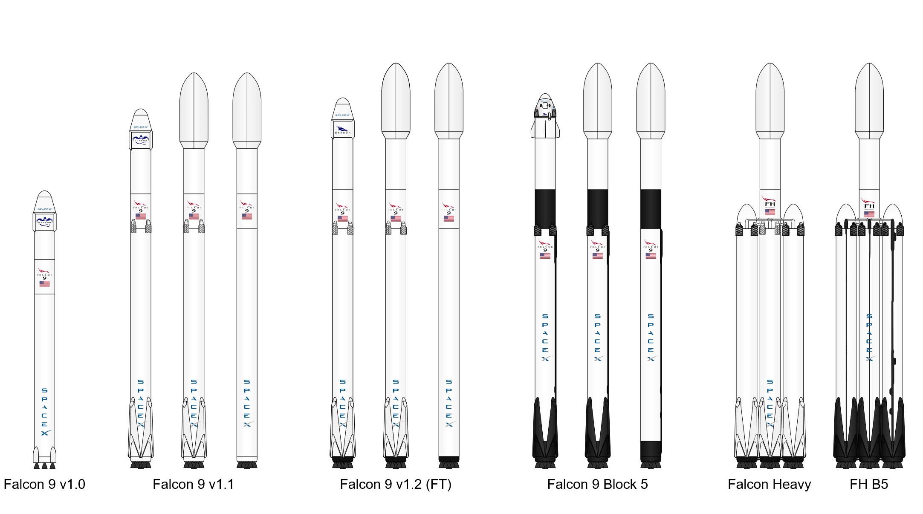
Introduction – SpaceX’s Mission Parameters
Some of the SpaceX’s mission parameters include:
Flight number, Rocket & Booster ID, Date
Crew, Customer & Payload Mass (kg)
Orbit
Launch Site (with latitude and Longitute)
Mission outcome
Links to othere resources
Which of these factors is important?
Source: https://en.wikipedia.org/wiki/List_of_Falcon_9_and_Falcon_Heavy_launches

Slide 6
Introduction – Objectives and Goal
Objectives:
To compile a dataset from different publicly accessible sources (e.g., APIs, Wikipedia).
To explore what features in the compiled dataset may affect landing outcome of a Falcon 9 rocket.
To determine which launch site(s) SpaceY should be operating on based on SpaceX’s operation.
To build and evaluate the performance of different classification models in predicting the landing outcome of a Falcon 9 rocket.
Goal
To develop a classification model to predict future landing outcome of a Falcon 9 rocket based on the selected features.

Slide 7

Section 1

Slide 8
Methodology
Overview
Data collection methodology:
Getting historical records from the SpaceX API
Web-scraping of the List of Falcon 9 and Falcon Heavy launches Wikipedia page
Perform data wrangling
Replacing Missing data, Standardizing values, etc.
Perform exploratory data analysis (EDA) using visualization and SQL
Perform interactive visual analytics using Folium and Plotly Dash
Perform predictive analysis using classification models
Build, tune, and evaluate 4 classification models

Slide 9
Data Collection
SpaceX API
Rocket Type
Wikipedia
Booster Version
Launch Site Info
Launch Site Coordinates
Outcome
Outcome
Payload Details
Payload Mass
Python codes were used to collect historical data from:
SpaceX API - https://api.spacexdata.com/v4/launches/past
Wikipedia page: List of Falcon 9 and Falcon Heavy launches
The 2 datasets were used as complements of each other.

Slide 10
Data Collection – SpaceX API
Call
Format
Read the response JSON file into a dataframe.
Clean-up
Filter for only Falcon9 data
Reset flight numbers
Call the SpaceX API (url) with a get request and store the response.
Convert codified data into human-readable formats.
For details, please check out the following file:
https://github.com/danielkwan783/IBM_DS_Capstone/blob/main/Notebooks/1_jupyter-labs-spacex-data-collection-api.ipynb

Slide 11
Data Collection - Scraping
Request
Extract
Extract the table contents using BeautifulSoup.
Format
Parse the extracted data into a dataframe.
Use a get request to get the html content of the Wikipedia page List of Falcon 9 and Falcon Heavy launches
For details, please check out the following file:
https://github.com/danielkwan783/IBM_DS_Capstone/blob/main/Notebooks/2_jupyter-labs-webscraping.ipynb

Slide 12
Data Wrangling
Missing values
Quick summaries
Replaced missing values with the mean (PayloadMass)
Calculate number of launches for each site
Defining target
Leaving as-is (LandingPad)
Grouped landing outcomes into success (class = 1) or failure (class = 0)
Calculate the occurrences of each orbit
Calculate the success rates
For details, please check out the following file:
https://github.com/danielkwan783/IBM_DS_Capstone/blob/main/Notebooks/3_labs-jupyter-spacex-Data%20wrangling.ipynb

Slide 13
EDA with Data Visualization
To answer if there is any correlation between flight number, payload mass, orbit type and outcome, the following plots were created:
Scatterplot of Flight Number vs Payload Mass coloured by outcome
Scatterplot of Flight Number vs Launch Site coloured by outcome
Scatterplot of Payload Mass vs Launch Site coloured by outcome
Bar graph of the success rate of each orbit type
Scatterplot of Flight Number vs Orbit coloured by outcome
Scatterplot of Payload Mass vs Orbit coloured by outcome
A line plot was also created to see the trend of changes in the success rate between 2010 and 2020
For details, please check out the following file:
https://github.com/danielkwan783/IBM_DS_Capstone/blob/main/Notebooks/5_edadataviz.ipynb

Slide 14
EDA with SQL
Ten (10) SQL queries were written to gain further insights into the data:
Identity of the unique launch sites
Records for launch site(s) starting with “CCA”
Total payload mass carried by the boosters launched by NASA (CRS)
Average payload mass by booster version F9 v1.1
The first successful landing outcome in ground pad date
The boosters landing successfully on drone ship with payload between 4000 and 6000 kg
Total number of successful and failure mission outcomes
The booster versions which have carried the maximum payload mass
The month for the booster failed to land on a drone ship
Rank of the landing outcomes by descending order
For details, please check out the following file:
https://github.com/danielkwan783/IBM_DS_Capstone/blob/main/Notebooks/4_jupyter-labs-eda-sql-coursera_sqllite.ipynb

Slide 15
Build an Interactive Map with Folium
To obtain a visual representation of the launch outcomes for the different launch sites, the following objects were added to a Folium map showing the launch sites:
Coloured circles for each launch site
Markers for each launch (red = failed; green = success) at the respective launch sites
Lines with labeled distance for points of interest around the launch site VAFB SLC-4E
For details, please check out the following file:
https://github.com/danielkwan783/IBM_DS_Capstone/blob/main/Notebooks/6_lab_jupyter_launch_site_location.ipynb

Slide 16
Build a Dashboard with Plotly Dash
To better understand the outcome for each launch site, an interactive dashboard has been created with the following controls and graphs:
Dashboard Controls:
Launch site selection menu (including options for “ALL” sites)
Payload slider selection (0 to 10,000 kg)
Output Graphs (for “ALL” sites):
A pie chart displaying the percentage of successful launches from each of the launch sites.
A scatter plot of payload mass versus the launch outcome
Output Graphs (for each launch site):
A pie chart displaying the outcome percentages (success (1) vs. failed (0)) of the selected launch site
A scatter plot of the selected payload mass versus the launch outcome for the selected launch site
For details, please check out the following file:
https://github.com/danielkwan783/IBM_DS_Capstone/blob/main/Python%20Script/spacex-dash-app.py

Slide 17
Predictive Analysis (Classification)
The following classification models were developed using the Sci-Kit Learn Library for Python:
Four (4) classification models were built: logistic Regression classifier, support vector machine (SVM) classifier, decision tree classifier, and k-Nearest Neighbors (KNN) classifier
Models were trained by 80% of the prepared data set, and accuracy score were calculated for evaluation.
A 10-fold GridSearchCV algorithm was used to search for the best hyperparameters for each model
The best models were selected based on the accuracy scores from the test data set
Classification model building
Cross Validation with hyperparameter tuning
Model evaluation using accuracy score
Splitting the data set
For details, please check out the following file:
https://github.com/danielkwan783/IBM_DS_Capstone/blob/main/Notebooks/7_SpaceX_Machine%20Learning%20Prediction_Part_5.ipynb

Slide 18
Results
The following results are presented in the next section:
Exploratory data analysis results
Interactive analytics demo in screenshots
Predictive analysis results

Slide 19

Section 2

Slide 20
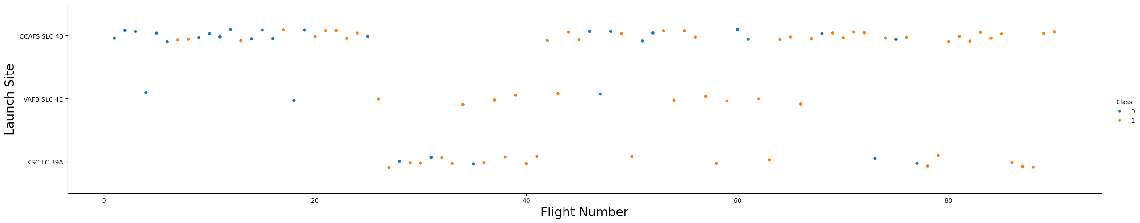
Flight Number vs. Launch Site
Flight numbers are plotted against launch site, with the markers indicating successful landing (Class = 1, orange) or failure (Class = 0, blue)
Failed missions were more frequent for the earlier flights.
Once the launch site KSC LC 38A are in operation (Flight #27), the success rate for the different sites does not vary substantially.

Slide 21
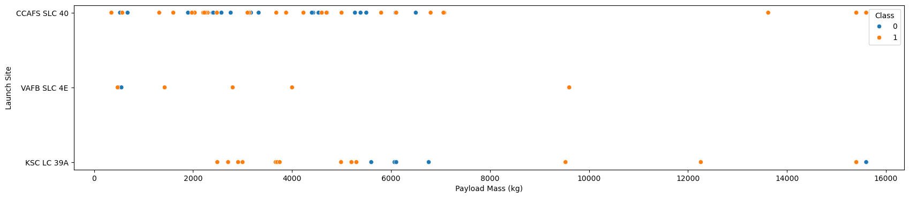
Payload vs. Launch Site
Payload mass (kg) are plotted against launch site, with the markers indicating successful landing (Class = 1, orange) or failure (Class = 0, blue)
The heavier payloads (> 10,000 kg) are only launched from CCAFS SLC 40 and KSC LC 39A in Florida.
There is no clear correlation between payload mass and outcome.

Slide 22
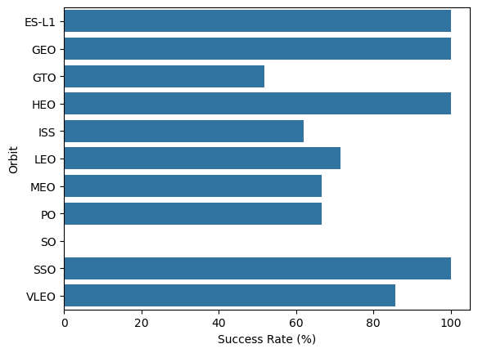
Success Rate vs. Orbit Type
Success rate (%) for each of the mission orbit types is shown.
Missions to ES-L1, GEO, HEO, and SSO have the highest success rate (100%)

Slide 23
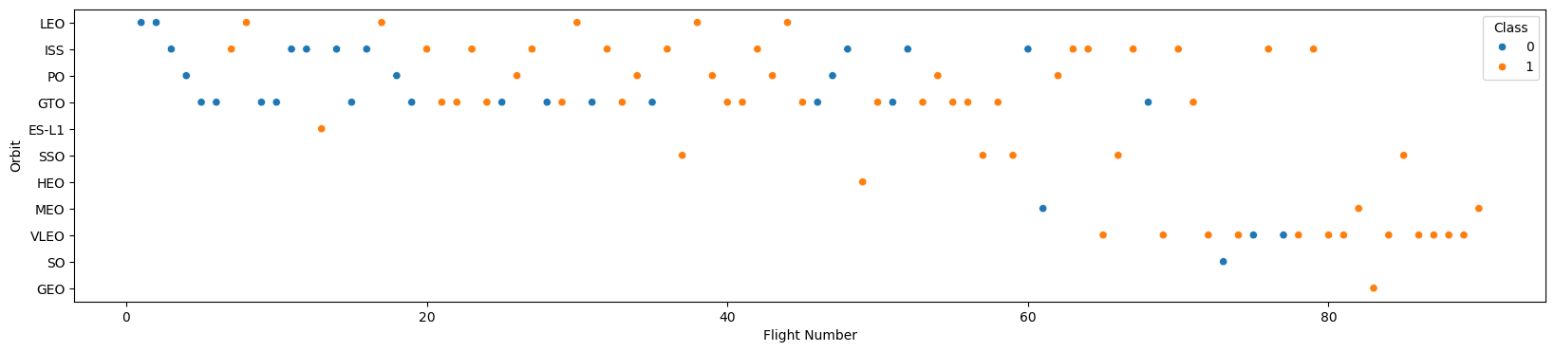
Flight Number vs. Orbit Type
Flight numbers are plotted against the orbit types, with the markers indicating successful landing (Class = 1, orange) or failure (Class = 0, blue)
Success rate for missions to LEO appears to be dependent on flight number.
For missions to the other orbit types, flight number does not appear to affect the success rate

Slide 24
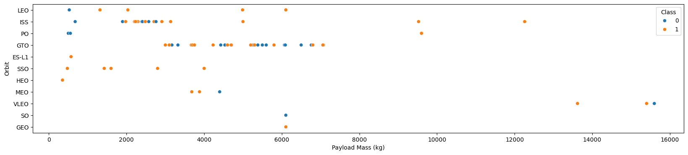
Payload vs. Orbit Type
Payload mass (kg) are plotted against the orbit types, with the markers indicating successful landing (Class = 1, orange) or failure (Class = 0, blue)
Heavier loads (> 10,000 kg) are mainly for ISS and VLEO.
Payload mass and orbit type do not appear to be related to the outcome.

Slide 25
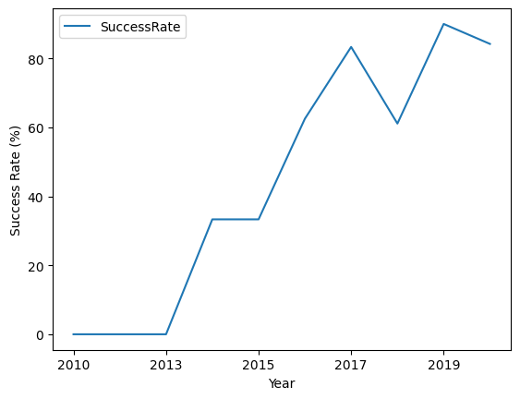
Launch Success Yearly Trend
Success rate (%) for each year is plotted in a line graph.
Success rate has been increasing substantially from 2013 (0%) to 2020 (over 80%).

Slide 26
All Launch Site Names
The unique launch sites are:
CCAFS LC-40
VAFB SLC-4E
KSC LC-39A
CCAFS SLC-40
CCAFS LC-40 is being renamed to CCAFS SLC-40 to align with SpaceX’s launch site code convention (for details, please refer to https://en.wikipedia.org/wiki/Cape_Canaveral_Space_Launch_Complex_40)

Slide 27
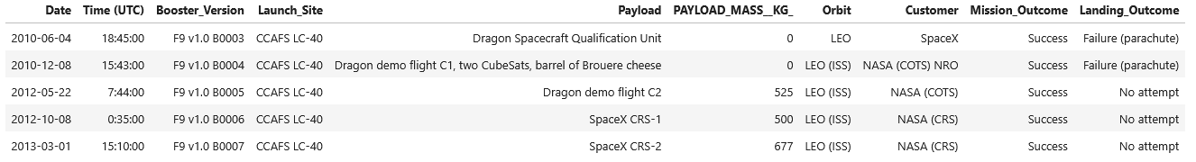
Launch Site Names Begin with 'CCA'
The older code name of CCAFS LC-40 is used for the earlier missions as shown below:

Slide 28
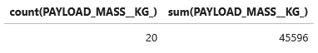
Total Payload Mass
Among the 20 missions for NASA (CRS), the total payload mass is 45596 kg as shown below:

Slide 29
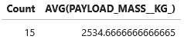
Average Payload Mass by F9 v1.1
Among the 15 missions carried by the booster version F9 v1.1, the average payload mass is 2535 kg as shown below:

Slide 30
First Successful Ground Landing Date
The dates of the first successful landing outcome on ground pad is 2015-12-22.
Mission details are shown below:

Slide 31
Successful Drone Ship Landing with Payload between 4000 and 6000
The names of boosters which have successfully landed on drone ship and had payload mass greater than 4000 but less than 6000 are:
F9 FT B1022
F9 FT B1026
F9 FT B1021.2
F9 FT B1031.2

Slide 32
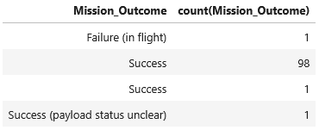
Total Number of Successful and Failure Mission Outcomes
The total number of successful and failure mission outcomes are:
Failed: 1
Success: 100
The numbers are calculated from the query result:

Slide 33
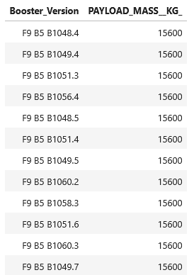
Boosters Carried Maximum Payload
The names of the 12 boosters which have carried the maximum payload mass (15,600 kg) are:

Slide 34
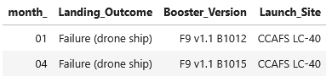
2015 Launch Records
In 2015, the failed landing outcomes on drone ship, their booster versions, and launch site names are:

Slide 35
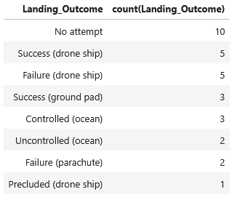
Rank Landing Outcomes Between 2010-06-04 and 2017-03-20
The counts of landing outcomes between the date 2010-06-04 and 2017-03-20 in descending order are shown below:

Slide 36

Section 3

Slide 37
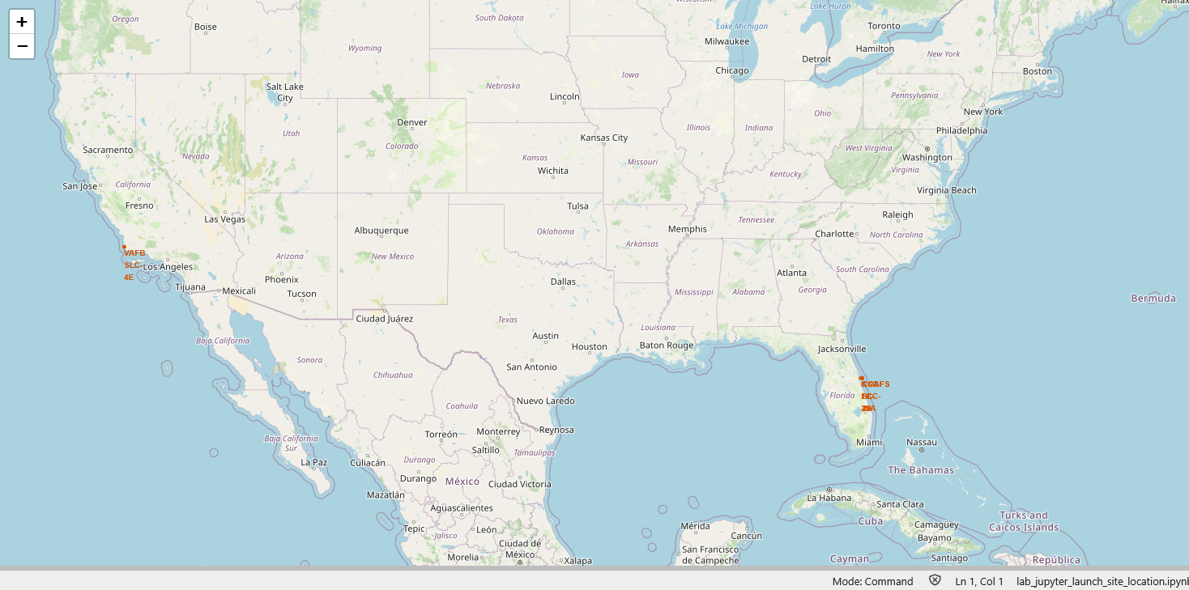
SpaceX Launch Sites
The following map shows the SpaceX launch sites (in Red) in Southern California and Florida

Slide 38
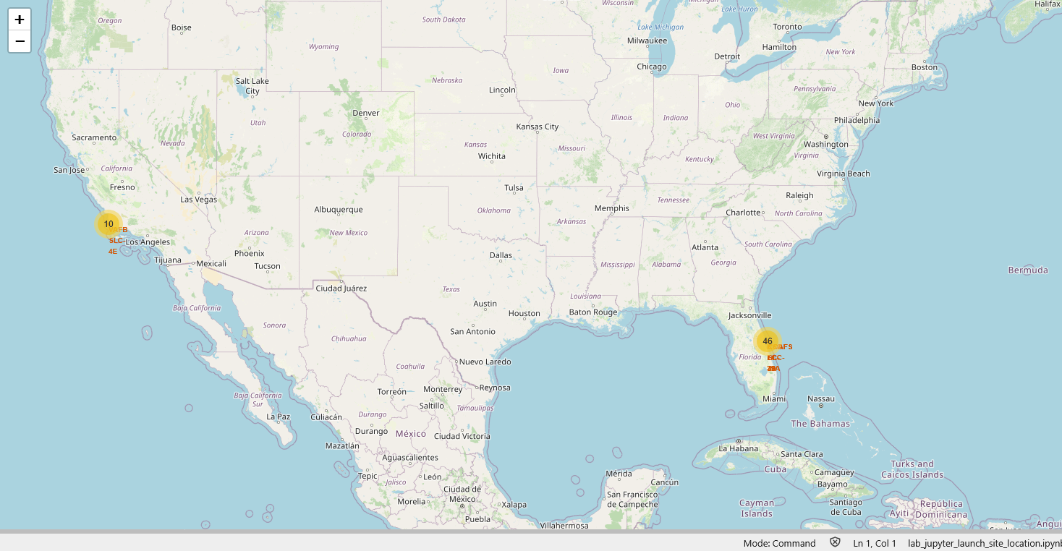
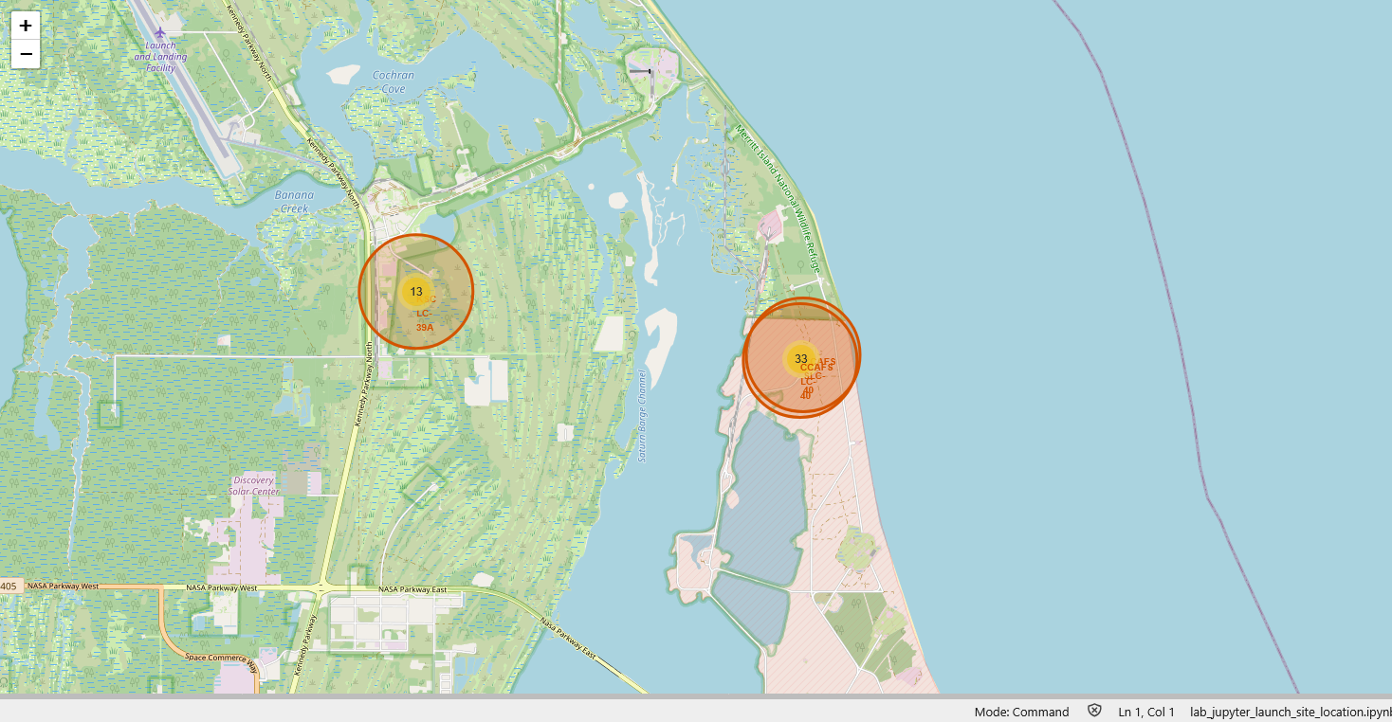
Falcon 9 Rockets Successful Launch Locations
The following maps show the number of successful landing missions launched from each of the launch sites.

Slide 39
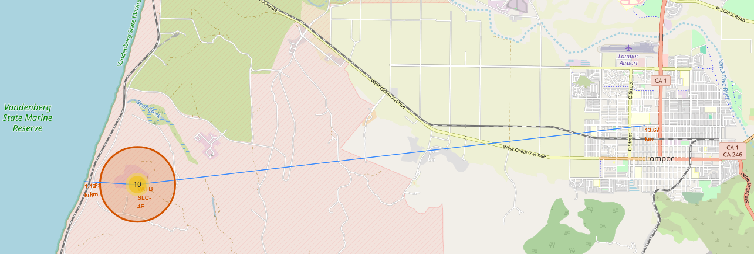
Distance from VAFB SLC-4E
The following map shows the distance from the launch site VAFB SLC-4E to the closest coast line (1.42 km) and city centre (Lompoc; 13.67 km).

Slide 40

Section 4

Slide 41
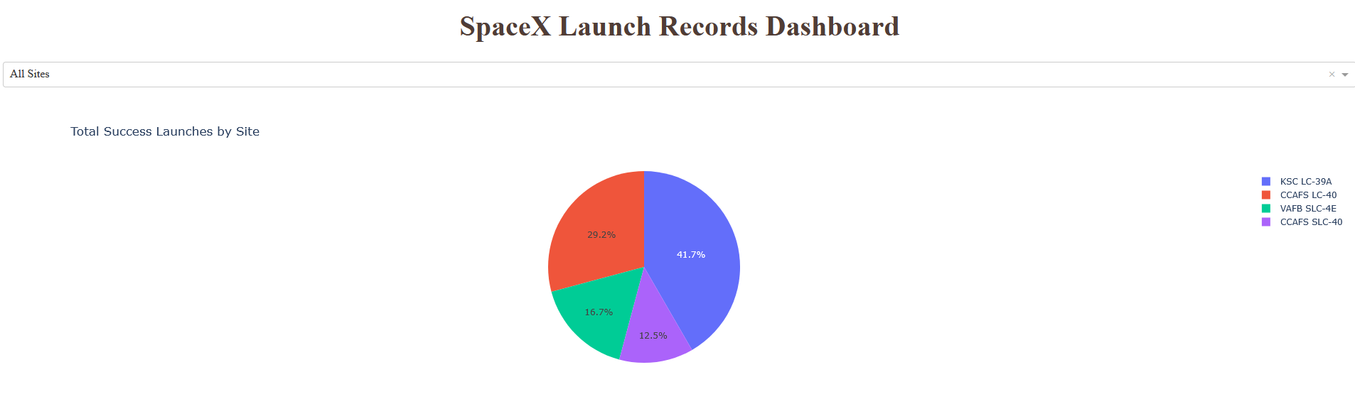
Dashboard – Successful Landing of All Sites
The following screenshot shows the percentage of successful landing mission from each of the launch sites

Slide 42
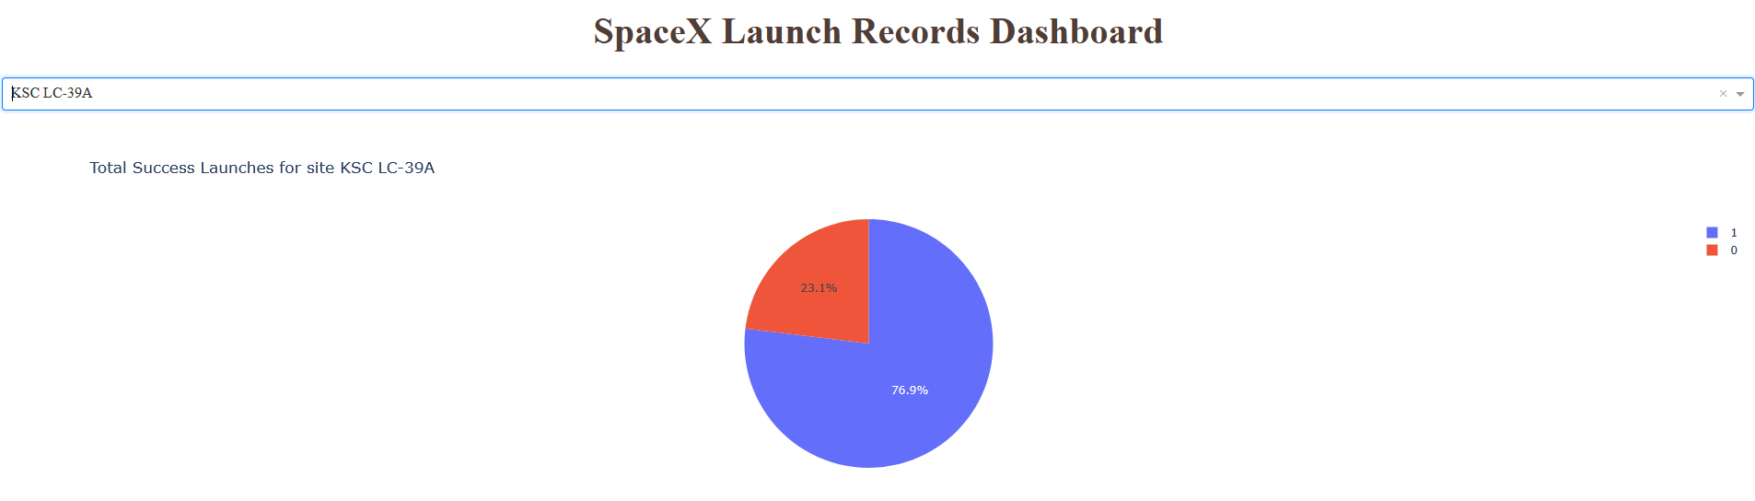
Dashboard – Launch Site with Highest Success Rate
When a specific launch site is selected from the dropdown list, the percentage of successful landing (blue; 1) and failed landing (Red; 0) are shown as a pie chart.

Slide 43
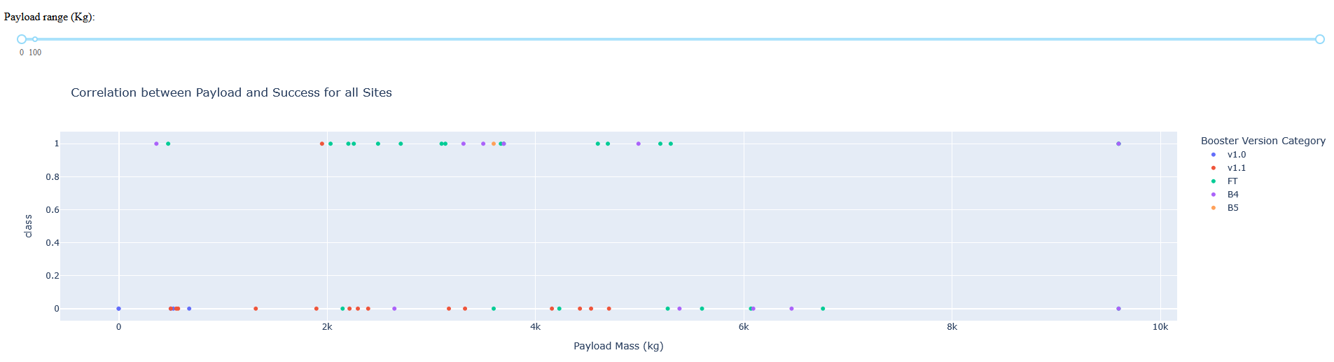
Dashboard – Payload Mass Slider
The dashboard also shows Payload Mass vs. Launch Outcome as a scatter plot for all sites with the booster versions shown as different colours.
The FT booster appears to have higher success rate than other boosters.

Slide 44

Section 5

Slide 45
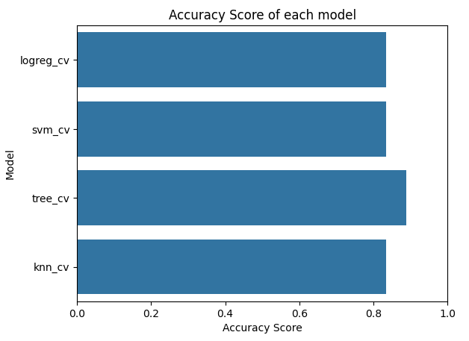
Classification Accuracy
The bar graph on the right shows the model accuracy (score) for all built classification models.
The Decision Tree Classification model has the highest score (0.889).

Slide 46
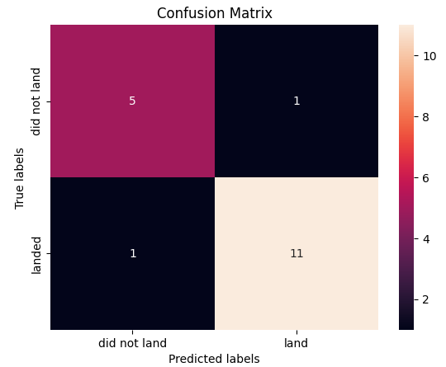
Confusion Matrix
The Decision Tree Classification Model correctly predicts 11 out of the 12 successful missions (bottom row) and 5 out of the 6 failed missions (top row).

Slide 47
Conclusions
Individual features such as launch sites, payload mass, and orbit type do not seem to correlate substantially with successful landing mission.
There is a clear improvement of success rate for SpaceX from 2013 (0%) to 2010 (over 80%).
Each of the launch sites is much closer to the coastline than to a city.
The highest success rate observed for a launch site is 76.9%.
Using features such as launch site, payload mass, orbit, booster version, grid fins collectively in a decision tree classification model can predict the correct landing outcome with 88.9% accuracy.

Slide 48
Appendix
For details, please refer to the following files on GitHub:
1_jupyter-labs-spacex-data-collection-api.ipynb
2_jupyter-labs-webscraping.ipynb
3_labs-jupyter-spacex-Data%20wrangling.ipynb
4_jupyter-labs-eda-sql-coursera_sqllite.ipynb
5_edadataviz.ipynb
6_lab_jupyter_launch_site_location.ipynb
7_SpaceX_Machine%20Learning%20Prediction_Part_5.ipynb
spacex-dash-app.py

Slide 49


